Slide 1
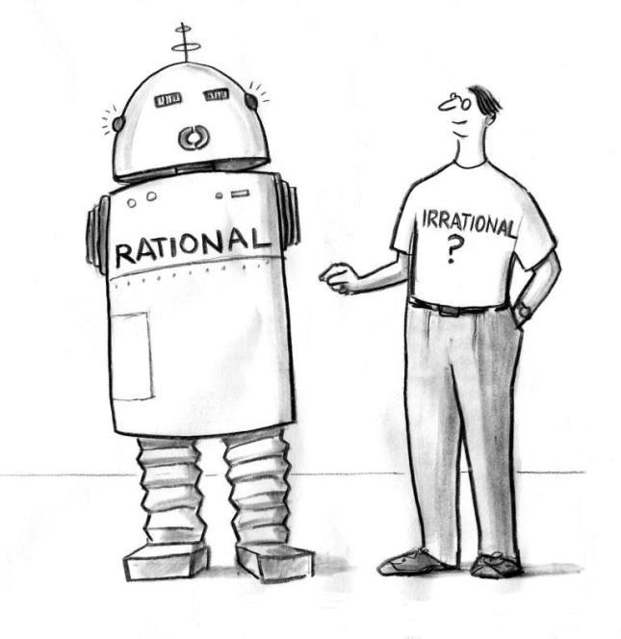
Epistemology and Rationality
Kareem Khalifa
Philosophy Department
Middlebury College

Slide 2
Overview
Epistemological Theories
P&C’s Analytical Theory
Naturalism
Generic Rationality

Slide 3
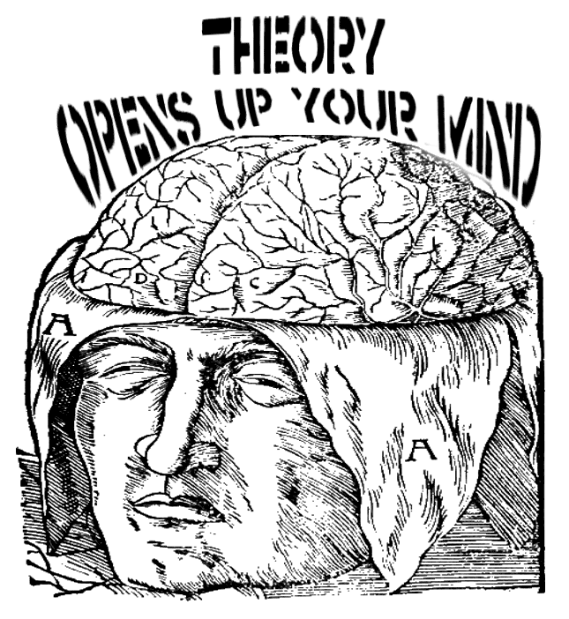
1. Epistemological Theories
1.1. Levels of theorizing
1.2. Kinds of cognition

Slide 4
2. Pollock and Cruz’s Analytical Theory

Slide 5
3. Naturalized Epistemology
3.1. Methodology of intuitions
3.2. Broad naturalism
3.3. Quinean naturalism
3.4. Compatibilist naturalism
3.5. Bootstrapping objection
3.6. Naturalist response

Slide 6
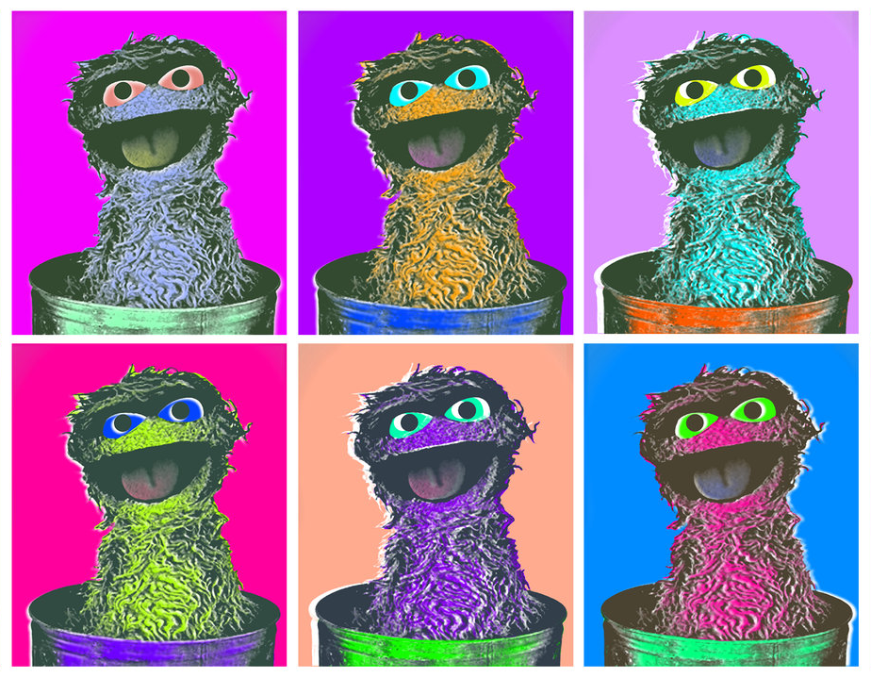
4. Generic rationality
4.1. How to evaluate it?
4.2. The Oscars
4.2.1. Oscar I
4.2.2. Oscar II
4.2.3. Oscar III

